Slide 1
What Ever Happened to…?
The St. Louis Park High School Class of 1963

Slide 2
Although he is a beloved Portland obstetrician, Al Ono was the obvious pick for master of ceremonies for the reunion for another reason.

Slide 3
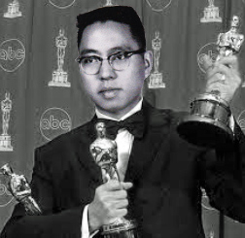
Al Ono

Slide 4
Art teacher, kitchen bath designer, band conductor, adoptive mother - Jackie Dubbe can do it all.

Slide 5
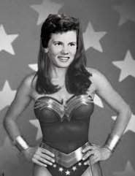
Jackie Dubbe

Slide 6
Carol Waataja learned that, at least in dental hygiene, size does matter.

Slide 7
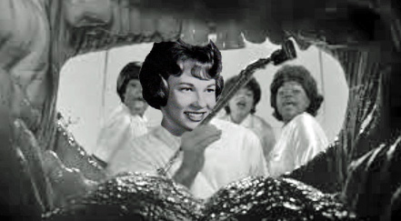
Carol Waataja

Slide 8
After Dianes 20th reunion dance, she disappeared for a few years. We found out where she went.

Slide 9
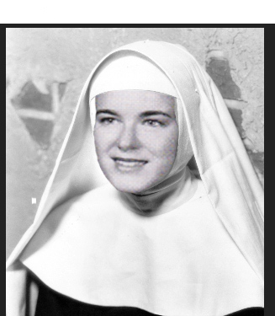
Diane Ward
Notes:
.

Slide 10
Karen Rogers honed her cheerleading talents in Dallas.

Slide 11
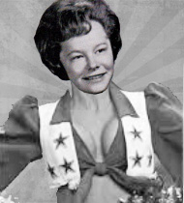
Karen Rogers

Slide 12
Bruce Fisher continued his basketball career and mentored some younger players along the way.

Slide 13
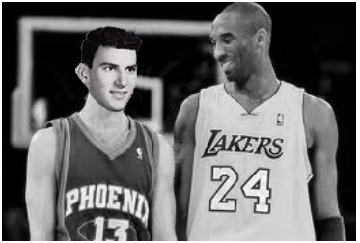
Bruce Fisher

Slide 14
Al Frisch had a great run as a pharmacist and was the model for the lead character in the TV series Breaking Bad.

Slide 15
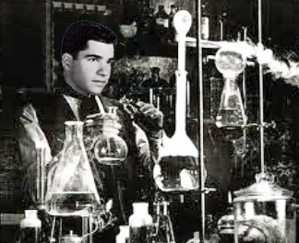
Al Frisch

Slide 16
Bruce Golob’s liberal leanings were apparent back when we were in high school. We can see how it influenced his later friendships.

Slide 17
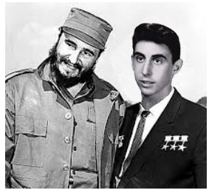
Bruce Golob

Slide 18
Barbara Pratt is a radio producer, political activist and feminist. She sometimes wears dresses that get her into trouble.

Slide 19
Barbara Pratt

Slide 20
Butch Freedland is a prominent LA attorney. Here he is with one of his lesser known clients.

Slide 21
Butch Freedland

Slide 22
Bob Miller moved. Can anyone guess where?

Slide 23
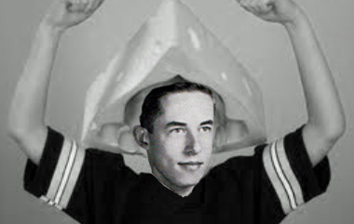
Bob Miller

Slide 24
Jim Malisow didn’t begin selling Cadillac’s – he had to work his way up.

Slide 25
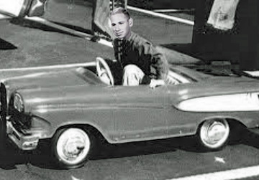
Jim Malisow

Slide 26
Terry Hamlin had a secret visit to Alaska and this is what resulted.

Slide 27
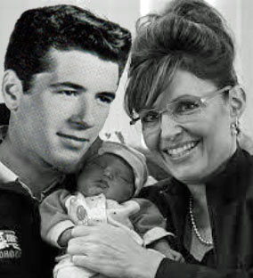
Terry Hamlin

Slide 28
This recently discovered picture of Cheryl (Chickie) Weinberg's birth explains everything.

Slide 29
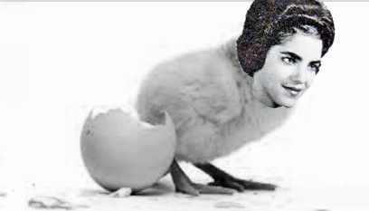
Cheryl “Chickie” Weinberg

Slide 30
Howard Katz has 8 grandchildren – an Octogrampa

Slide 31
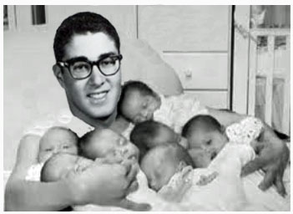
Howard Katz

Slide 32
And he exploited his circumstances shamelessly.

Slide 33
Howard Katz

Slide 34
This one for Nancy Sergeant was too easy, so we had to do another one . . .

Slide 35
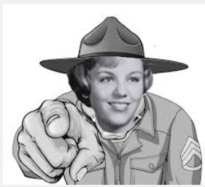
Nancy Sargeant

Slide 36
Nancy was a micro-biologist. What is a microbiologist, you might ask. Here is a biologist, a micro-biologist and a molecular biologist.

Slide 37
Nancy Sargeant

Slide 38
What more can we say about Diane Cannon!

Slide 39
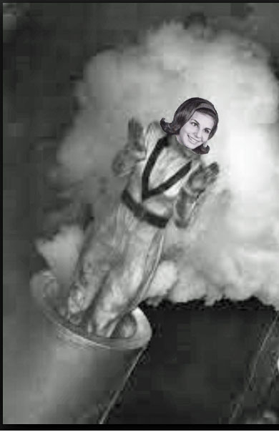
Diane Cannon

Slide 40
Who has the best name ever?

Slide 41
Clue!

Slide 42
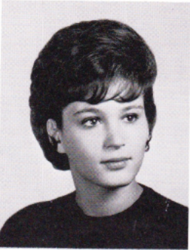
Idy Klein

Slide 43
Bill Ludwell was a food inspector and he worked for Butterball. Chickie, if he approaches you over the weekend, run away.

Slide 44
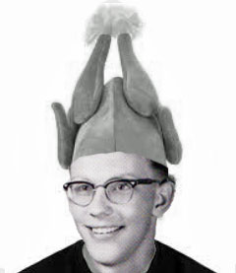
Bill Ludwil

Slide 45
We always wondered why Phil Homme sat on the track during meets. Now we know.

Slide 46
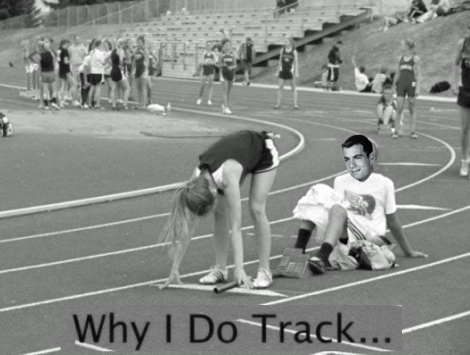
Phil Homme

Slide 47
Fern’ Rosoff’s ran a company that produced jingles in NY. She met her husband Philip who is from Australia.

Slide 48
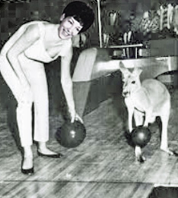
Fern Rosoff

Slide 49
Rick Zuckman was suspended from the Co-ed soccer league immediately after the singing of the national anthem.

Slide 50
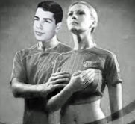
Rick Zuckman

Slide 51
Ricki Mayes’ souvenir from her trip to Italy. He said she was his one and only.

Slide 52
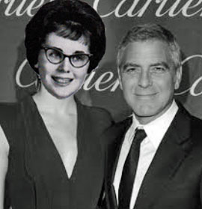
Ricki Mayes

Slide 53
John Valentine’s track success advanced substantially when he began running in the 90 and above events.

Slide 54
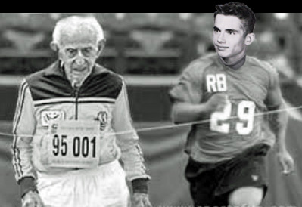
John Valentine

Slide 55
Jon Liss still owns national camera exchange. You should be able to recognize him at dinner tomorrow night.

Slide 56
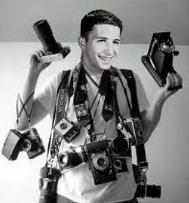
Jon Liss

Slide 57
Bob Dockman is not just an insurance agent – he is the king of insurance agents

Slide 58
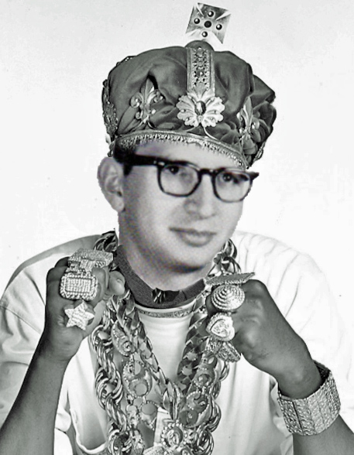
Bob Dockman

Slide 59
Bruce Ritchie went from the swim team to modeling adult swimwear.

Slide 60
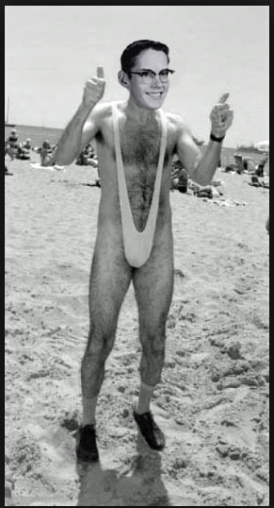
Bruce Ritchie

Slide 61
David Johnson considered a run for governor now that Jessie Ventura is out of politics.

Slide 62
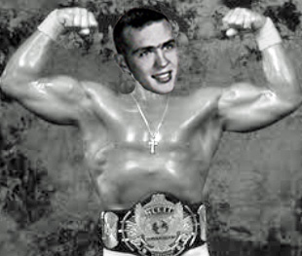
David Johnson

Slide 63
Bob Copeland and Karen Olson here pictured on their wedding day and next as they were leaving on their honeymoon.

Slide 64
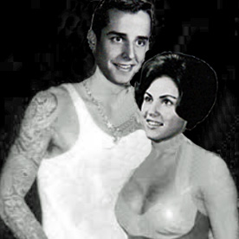
Karen Olsen/Bob Copeland

Slide 65
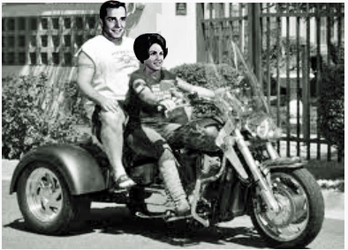
Bob Copeland/Karen Olsen

Slide 66
Judy Bowers went from working on the junior class play to Hollywood where she helped out this young actor.

Slide 67
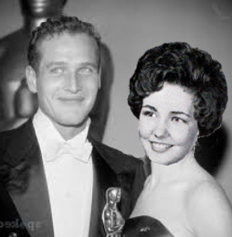
Judy Bowers

Slide 68
Diane Ward was very sad when she wasn’t selected homecoming queen. However dreams never die. We’re happy to say she achieved her goal.

Slide 69
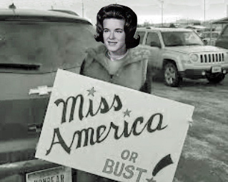
Diane Ward

Slide 70
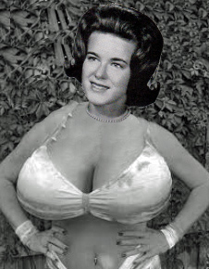
Diane Ward

Slide 71
There was recently an opening for a job at the Vatican. A few of our classmates applied for the job. Although each could have done the job, as the following pictires demonstrate, none were selected, which makes usfeel as though the Vatican might not be an equal opportunity employer.

Slide 72
Marshall Lebow
Notes:
– Pope Marshall

Slide 73
Doug Savitt
Notes:
Pope Doug

Slide 74
Bob Shiff

Slide 75
Roger Harrington was Kicked out of the band for radical hair style.

Slide 76
Roger Harrington

Slide 77
Richard, The Body, Sweet contemplating running for governor of Minnesota.

Slide 78
Richard Sweet

Slide 79
Apparently dancing with the Parkettes and swimming with the Surfbelles, got Sue Shol noticed after high school.

Slide 80
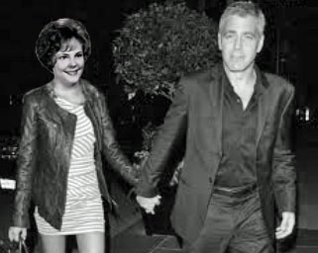
Sue Shol

Slide 81
Sandy Swanson was the first person in our class to have a “destination wedding.”

Slide 82
Sandy Swanson

Slide 83
Vic Lewis was always deeply involved in sports – sometimes too deeply.

Slide 84
Victor Lewis

Slide 85
Roland Carlson’s search for a life adventure was cut short when he was bounced out of the Hells Angels for being too clean cut. Sadly, a life of normalcy, success and a little hockey followed.

Slide 86
Roland Carlson

Slide 87
Louise Borgman - The Class of 63’s emissary to finally determine if Tom Cruise is gay or straight.

Slide 88
Louise Borgman

Slide 89
Ron Barr has had a lifelong career as a dermatologist but for some reason people kept getting under his skin.

Slide 90
Ron Barr

Slide 91
Sandy Kohan Kept up her reputation as the fastest girl in the class. Just kidding Sandy.

Slide 92
Sandy Kohan

Slide 93
Steve Jacobsen pictured with his new caddy.

Slide 94
Steve Jacobson

Slide 95
Len Jackson doesn't play the horses, he plays with horses. Big difference.

Slide 96
Len Jackson

Slide 97
How Judy Kuenann’s husband from South Dakota shows his appreciation – lucky Judy.

Slide 98
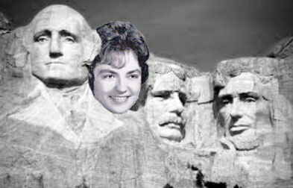
Judy Kuennen

Slide 99
Lawyers all have delusions of grandeur, but Mike London’s sometimes got the better of him.

Slide 100
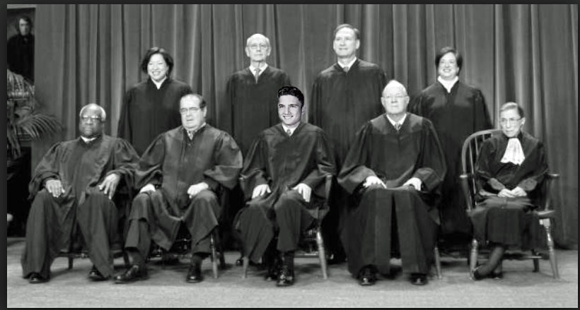
Mike London

Slide 101
Nancy Wolff may have been a demur member of Spanish club, but she showed a wild side after graduation.

Slide 102
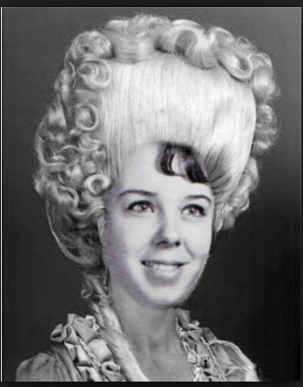
Nancy Wolff

Slide 103
Nancy Vogt’s successful career as a hairstylist hit a little “snag” somewhere along the way.

Slide 104
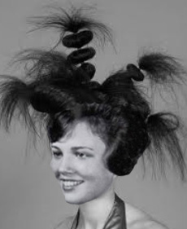
Nancy Vogt

Slide 105
Here is Jeff McFarland trying out the idea of a post retirement effort at promoting boxing .

Slide 106
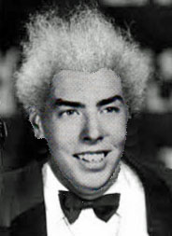
Jeff McFarlane

Slide 107
After retiring from Nike, Jim Burmaster went to work for Chia Pet.

Slide 108
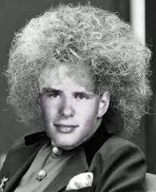
Jim Burmaster

Slide 109
Rumors are that Louise Klingel may have posed for Picasso.

Slide 110
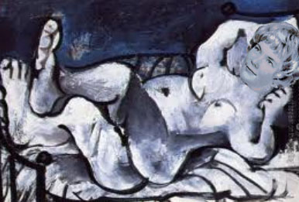
Louise Klingel

Slide 111
Pete Gufstafson continued his hockey career in a very special league.

Slide 112
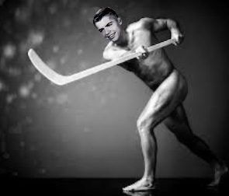
Peter Gustafson

Slide 113
Here is Sue Adelshiem getting ready for sailing with her husband in a sailboat around the world .

Slide 114
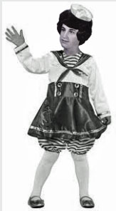
Sue Adelsheim

Slide 115
Work as a radiologist just got the best of Steve Brawerman.

Slide 116
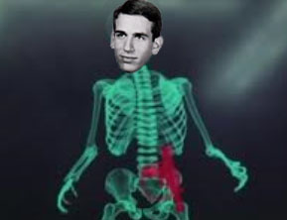
Steve Brawerman

Slide 117
Sue Skinner had triplet grandchildren – guess whose genes were dominant.

Slide 118
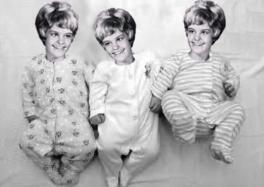
Sue Skinner

Slide 119
Jay Hanson Thought joining the Elks would give him the upper hand in hunting. Obviously he misunderstood something.

Slide 120
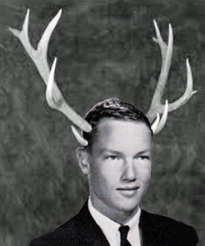
Jay Hanson

Slide 121
Nancy lebow moved to Ohio for a good reason. She won an athletic scholarship to play quarterback for the Ohio State football team where she excelled.

Slide 122
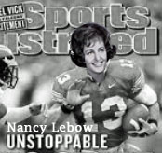

Slide 123
Life as a pediatrician just wasn’t fulfilling enough for Jeff Liebo.

Slide 124
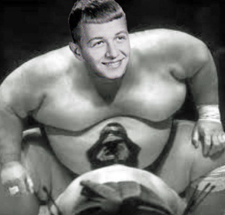
Jeff Liebo

Slide 125
Midge Berset was a daring snowmobiler, but her Midwestern upbringing cautioned her to leave instructions in case anything went wrong.

Slide 126
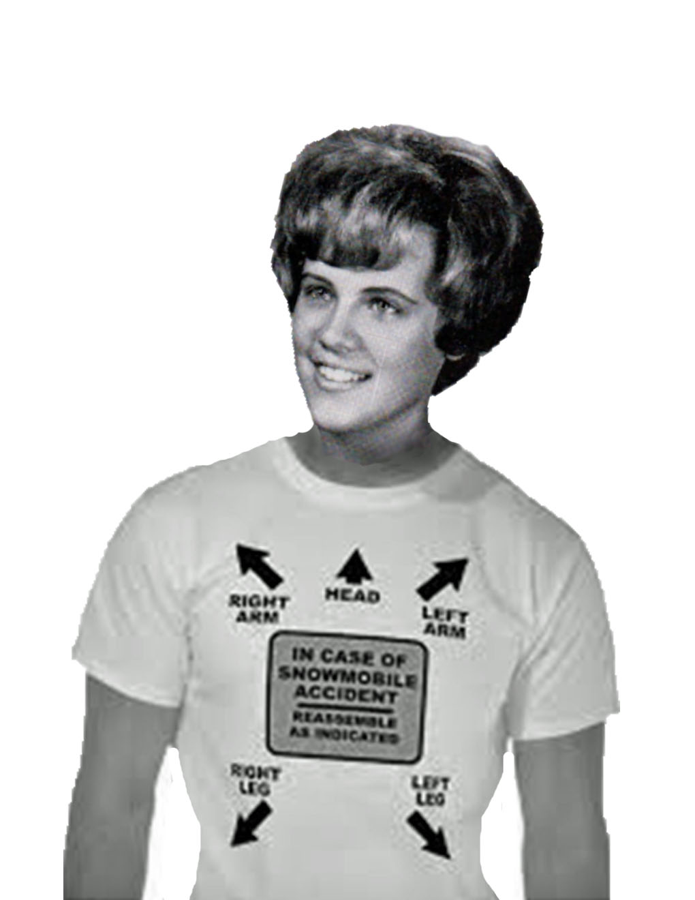
Midge Berset

Slide 127
Jeri Waldoch at a city council meeting in her hometown of... Boring, Oregon.

Slide 128
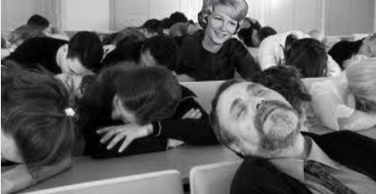
Jeri Waldock

Slide 129
Chris Johnson isan avid water-skier. We found this rare picture of Chris on his wedding day.

Slide 130
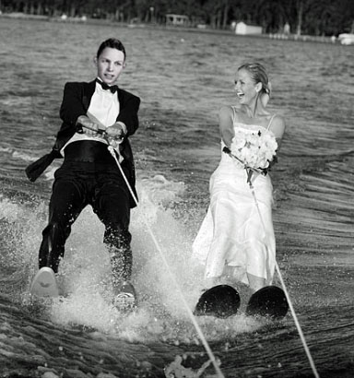
Chris Johnson

Slide 131
Sandy Pollok’s effort to capitalize on her Surfbelle career ended badly when she hooked up with 6 unsynchronized swimmers.

Slide 132
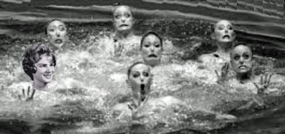
Sandra Pollock

Slide 133
This explains why Rikie Mayes won’t talk to Susan Fuehrer.

Slide 134
Susan Fuehrer

Slide 135
Peggy’ Dahlberg’s attempt to upgrade from flight attendant to pilot did not sit well with some of her colleagues.

Slide 136
Peggy Dahlberg

Slide 137
Susan Fisher has her PhD in linguistics; her specialty (no kidding) is comparing Western sign language to Japanese sign language. We think she chose this specialty in anticipation of this reunion presentation.

Slide 138
Susan Fischer

Slide 139
Susan Fischer

Slide 140
Mike Larimer has had some success as a financial planner.

Slide 141
Mike Larimer

Slide 142
Mike’s Bathroom

Slide 143
Anna Anderson always loved hats – and fruit.

Slide 144
Anna Anderson

Slide 145
Sharyl Wilson loves hats, too, but is not a vegetarian.

Slide 146
Sharyl Wilson

Slide 147
Barb Herwitz told us went back to work after moving to Las Vegas.

Slide 148
Barb Herwitz

Slide 149
Judy Anderson’s husband may be treating her too well.

Slide 150
Judy Anderson

Slide 151
Jim Conn graduated from the Navel Academy – and is proud of it.

Slide 152
Jim Conn

Slide 153
Bruce Horning’s stint as a motorcycle helmet inventor didn’t pan out so well.

Slide 154
Bruce Horning

Slide 155
While most people thought Carol Kimball was dedicated to psychology and higher education, those who know her best have a somewhat different view.

Slide 156
Carol Kimball

Slide 157
Back of Carol’s Van

Slide 158
Edie Levinson is a psychotherapist who specializes in working with cross-dressers. Here she is with one of her successful outcomes.

Slide 159
Edie Levenson

Slide 160
Prairie City never saw a police chief like Chuck – “Make My Day” – Grover.

Slide 161
Chuck Grover

Slide 162
Bonnie McDonald had a better comb-over than her real estate colleague.

Slide 163
Bonnie McDonald

Slide 164
Andy Davis - Beloved math teacher.
.

Slide 165
Andy Davis

Slide 166
Andy pictured here with some of his fellow math teachers.

Slide 168
Dawn Harland collects and loves Mustangs – perhaps too enthusiastically!

Slide 169
Dawn Harland

Slide 170
Mike Englebert knows that you can never practice putting too much.

Slide 171
Mike Englebert

Slide 172
John Zimmerman plays a little golf as well – pictured here with some of his golf buddies.

Slide 173
John Zimmerman

Slide 174
Joanne Jackson was Director of public affairs for the Carnegie Council, but really came to NY with other dreams . . .

Slide 175
Joanne Jackson

Slide 176
And achieved them.

Slide 177
Joanne and fellow Rockettes

Slide 178
Alexis George Raises unusual racehorse. Here she is on one of her favorites.

Slide 179
Alexis George

Slide 180
Bode Zietz - Once a swimmer, always a swimmer.

Slide 181
Bode Zietz

Slide 182
Ken Payne gave singing lessons to this fellow – too bad things didn’t work out for him.

Slide 183
Ken Payne

Slide 184
Gene Rasmussen with the 1963 track team.

Slide 185
Gene Rasmussen

Slide 186
And with a short-lasting girlfriend.

Slide 187
Gene Rasmussen

Slide 188
As it said in our yearbook, Joan Snowden is a wholesome girl - so wholesome that they put her picture on a truck.

Slide 189
Joan Snowden

Slide 190
Betsy Feedland sat for a portrait by her Italian boyfriend . . . Lenny something.

Slide 191
Betsy Freedland

Slide 192
Carolyn Anthony auditioned for a part in Star Wars – she should have gotten it!

Slide 193
Carolyn Anthony

Slide 194
While Jeff Freund went on to an illustrious career in law, his success at the 1968 and 1972 Olympics is often overlooked.

Slide 195
Jeff Freund

Slide 196
Lynn Gesking is an avid boater but has a morbid fear of ice cubes.

Slide 197
Lynn Geseking

Slide 198
Greg Amluxen likes boating as well – Greg, you and Lynn should get together – but mind the ice cubes.

Slide 199
Greg Amluxen

Slide 200
After Senior Chorus, Marilyn Libby briefly sang in a group called “Sonny and Mar” but was thrown over for a younger woman.

Slide 201
Marilyn Libby

Slide 202
Richard Kutz was known for his innovative Science class teaching techniques.

Slide 203
Richard Kutz

Slide 204
Harriet Malin took her interest in physical therapy just a little too far. Be careful shaking hands with, or hugging, Harriet this weekend.

Slide 205
Harriet Malin

Slide 206
Mike Hanson loves fishing with different types of bait. Pictured here about to get a bite.

Slide 207
Mike Hanson

Slide 208
Ed Omiya Lives in Hawaii, a shame he still needs floaties to go surfin.’

Slide 209
Ed Omiya

Slide 210
Chris Gayle is revered by her students at Barton Open school in Mpls, but they may have gone too far on her portrait.

Slide 211
Chris Gale

Slide 212
John Cheleen was an outstanding teacher and VP of our class who obviously needed more excitement during his summer vacations.

Slide 213
John Cheleen

Slide 214
Jane Sandsted was chief nursing officer of Hutchinson Community Hospital. Big job. Sadly, small uniform.

Slide 215
Jane Sandstad

Slide 216
Bonnie Nordin does Medicare billing, an important job for all of us, and apparently she’s very good at it.

Slide 217
Bonnie Nordin

Slide 218
A multi-sport participant in high school, Ron Johnson is still very active and in shape as you can see.

Slide 219
Ron Johnson

Slide 220
Perci Chester is a well-known artist. Perhaps her greatest work was her self portrait.

Slide 221
Perci Chester

Slide 222
Diane Chalfen returned from Italy to raise her family in Minnesota and perfect her recipe for spaghetti and meatballs.

Slide 223
Diane Chalfen

Slide 224
Mike Brown is a consultant. Looks like he really knows how to build client loyalty.

Slide 225
Michael Brown

Slide 226
Mike Gilliam was Star athlete at Park who continued sports participation – sometimes to the bitter end.

Slide 227
Michael Gilliam

Slide 228
Finally, the answer to why Nancy Levine rejected so many boys in high school. Seems her standards were extremely high.

Slide 229
Nancy Levine

Slide 230
As a contractor and a remodeler, Phil Payne was a specialist in filling cracks.

Slide 231
Phil Payne

Slide 232
Rod Morseth Planned on becoming an automobile mechanic. Don’t know how that ended up, but we know how it started.

Slide 233
Rod Morseth

Slide 234
Richard Ekstrum has played bridge for thousands of hours according to his profile. His motto explains his devotion to the game.

Slide 235
Richard Ekstrum

Slide 236
Rollie Brickman was a probation officer but always dreamed of bigger things.

Slide 237
Rollie Brickman

Slide 238
Jim Laurie is a book seller in a time when, as you can see, that’s not an easy job.

Slide 239
Jim Laurie

Slide 240
Greg Shank was treasurer of sophomore class and student council and president of all school Hi Y. But his dream was to own a chocolate factory.

Slide 241
Greg Shank

Slide 242
Jane Thorbeck’s career in psychology led to her discovery that “sometimes a cigar is just a cigar.”

Slide 243
Jane Thorbeck

Slide 244
Andrea Gorel’s press photography career led to connections with interesting subjects.

Slide 245
Andrea Gorel

Slide 246
While Charles Gill was known for his cross dressing costumes at pep fests, he showed his studly side after high school.

Slide 247
Charles Gill

Slide 248
Steve Levitus was a successful insurance agent. Perhaps you’ve seen his commercials.

Slide 249
Steve Levitus

Slide 250
Patrick Greffin was a Navy corpsman medic shown here with some of his pals.

Slide 251
Patrick Greffin

Slide 252
Mahryam Daniels as a therapist coined the therapy term “tough love.”

Slide 253
Mahryam Daniels

Slide 254
Barb Bowers Has a secret, exclusive relationship with someone we all know. Shh!

Slide 255
Barb Bowers

Slide 256
Oops, Sheila Reiter seems to have had a secret, exclusive relationship with someone we all know. (This picture was photo shopped to make the boy friend’s eyes look straight ahead).

Slide 257
Sheila Reiter

Slide 258
Oy, it appears that Pat Jesperson has a secret, exclusive relationship with someone we all know. Again this was photo shopped to make his eyes look straight ahead.

Slide 259
Pat Jesperson

Slide 260
Terry Hawkins went from Blue Tri club in high school to a very different club after graduating.

Slide 261
Terry Hawkins

Slide 262
We found the picture that captured the moment John Skartvedt announced he was a Democrat.

Slide 263
John Skartvedt

Slide 264
Marilyn Quello is having a nice life, but never got over being a homecoming queen candidate.

Slide 265
Marilyn Quello

Slide 266
Ever wonder what Paul Kronick did in Central America? We’re not sure but we think it was revolutionary.

Slide 267
Paul Kronick

Slide 268
Mary Skalet filled lots of different roles for Hopkins schools, but is known now for her artist skills. Especially with fabric and yarn. Ah, it’s not polite to point Mary.

Slide 269
Mary Skalet

Slide 270
Marshall Schwartz is a successful doctor in real life, but we all have come to know him as Dr. McSteamy on TV.

Slide 271
Marshall Schwartz

Slide 272
Kathy Martin was Glee Club singer who turned to a successful career at IBM and as a mom after her professional tryout somehow failed.

Slide 273
Kathy Martin

Slide 274
Marilyn Vinokour was a dedicated teacher for Hopkins schools, but even she would have to take a break sometimes.

Slide 275
Marilyn Vinokour

Slide 276
Gene Erickson was disappointed that the fur lined jock strap Mr. Griak promised him never showed up. Until today.

Slide 277
Gene Erickson

Slide 278
SEE YOU ALL AT OUR 60th

Slide 279
Want your photo?
E-mail:
lieboje@hotmail.com

